Slide 1
Retrofit in Android
Week 10-12

Slide 2
Retrofit in Android

Slide 3
Contents
What is an API?
What is Retrofit?
Client and Server
Permissions needed
Dependencies needed

Slide 4
Retrofit in Android

Slide 5
What is an API?
API is the acronym for application programming interface, a software intermediary that allows two applications to talk to each other. APIs are an accessible way to extract and share data within and across organizations.

Slide 6
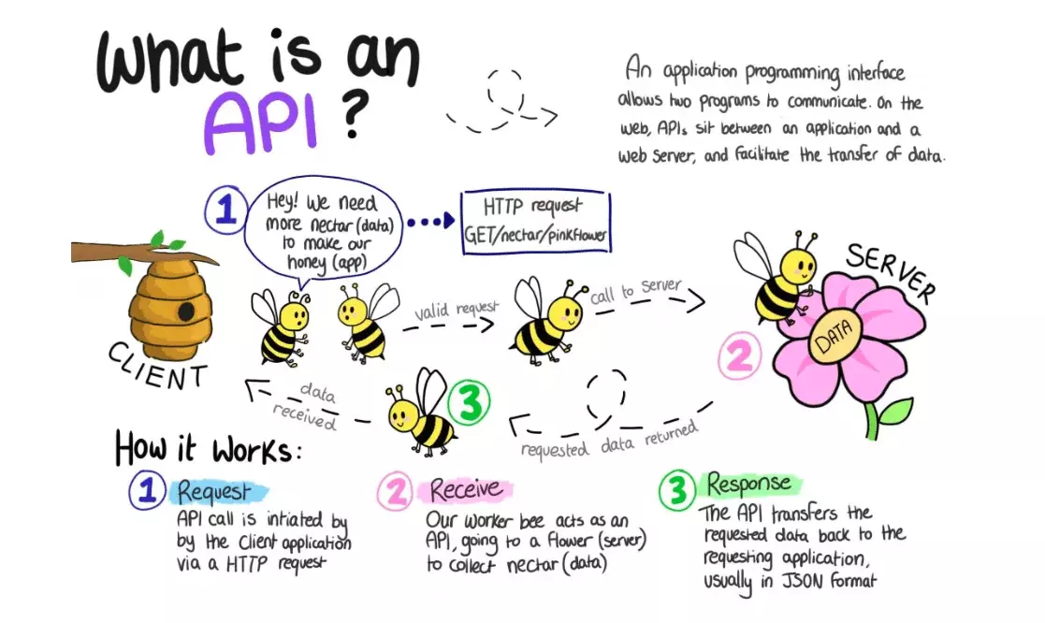
What is an API?

Slide 7
What is an API?
APIs are all around us.
Every time you use a rideshare app, send a mobile payment, or change the thermostat temperature from your phone, you’re using an API.

Slide 8
What is an API?
When you use a mobile app, they connect to the Internet and send data to a server.
The server then retrieves that data, interprets it, performs the necessary actions, and sends it back to your phone.
The application then interprets that data and presents you with the information you wanted in a readable way.

Slide 9
What is Retrofit?
In the world of Android app development, making network requests to fetch data from APIs is a common task.
Retrofit is a powerful and popular library that simplifies this process by providing a clean and efficient way to make API calls.

Slide 10

What is Retrofit?
Retrofit is a type-safe HTTP client for Android and Java developed by Square.

Slide 11
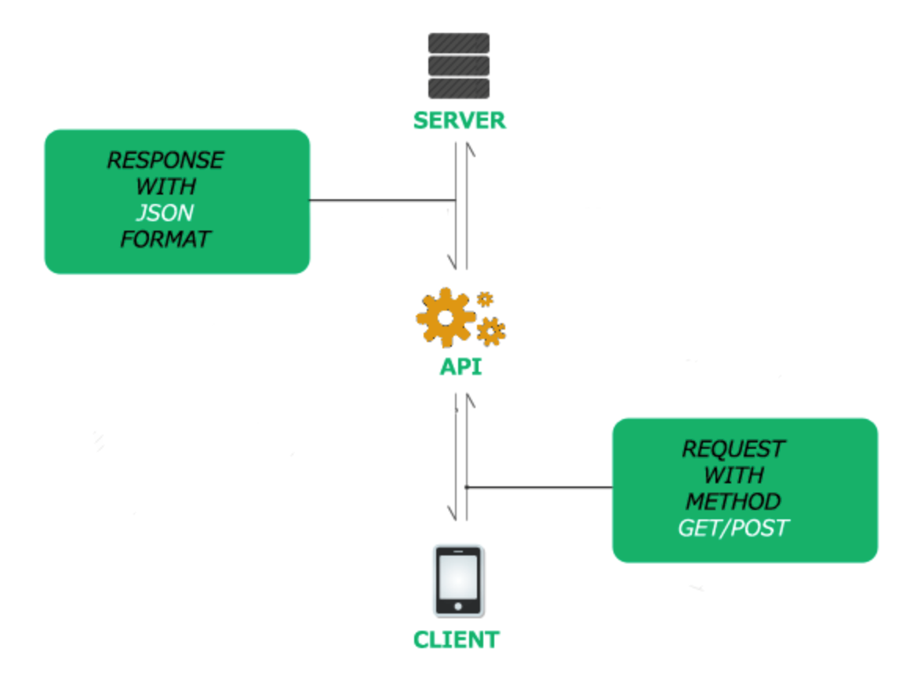
Client and Server

Slide 12
Permissions needed
<uses-permission android:name="android.permission.INTERNET"/>

Slide 13
Dependencies needed
implementation 'com.squareup.retrofit2:converter-gson:2.9.0’
implementation 'com.squareup.retrofit2:retrofit:2.9.0'

Slide 14
References
https://square.github.io/retrofit/
https://www.mulesoft.com/resources/api/what-is-an-api

Slide 15
END

